Slide 3
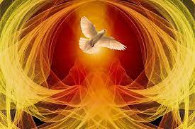

Slide 5
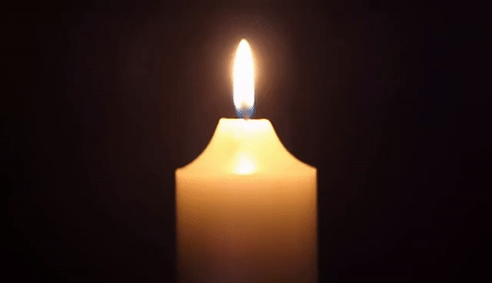
Lighting the Christ Candle

Slide 7
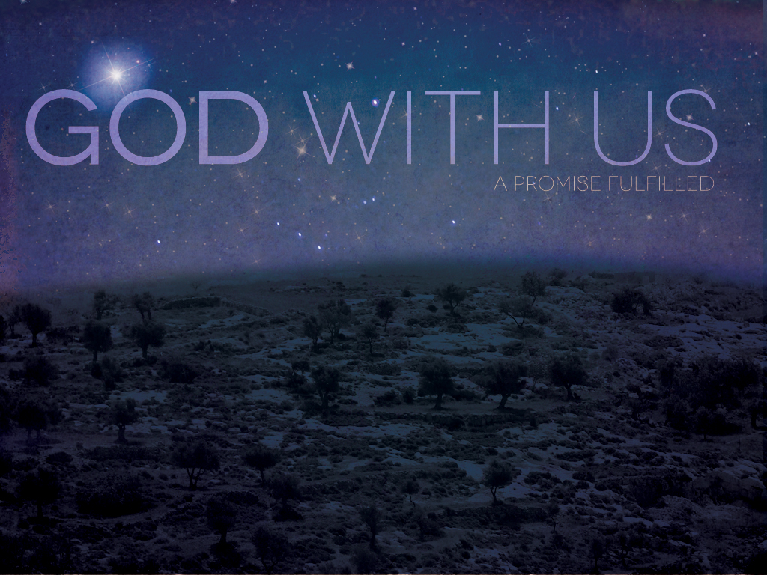
The Lord be with you
And Also With You

Slide 8
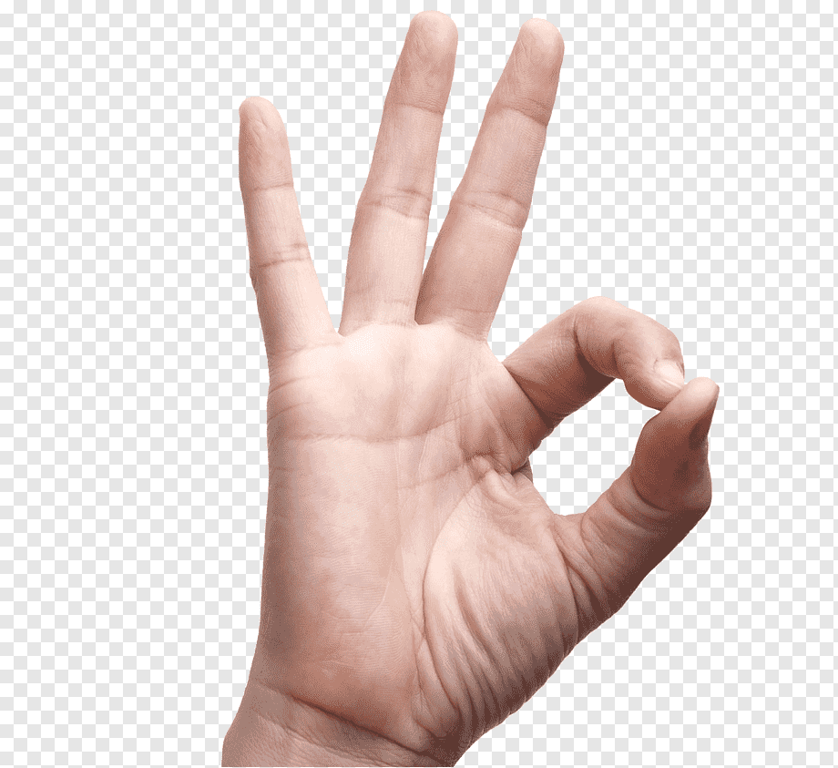
Sign of Peace

Slide 10
24 O Lord, how manifold are Your works!
In wisdom You have made them all;
the earth is full of Your creatures.
25 Yonder is the sea, great and wide,
creeping things innumerable are there,
living things both small and great.

Slide 11
26 There go the ships,
and Leviathan
that You formed to sport in it.
27 These all look to You
to give them their food in due season;

Slide 12
28 when You give to them, they gather it up;
when You open Your hand,
they are filled with good things.
29 When You hide your face,
they are dismayed;
when You take away their breath,
they die and return to their dust.

Slide 13
30 When You send forth Your spirit,
they are created;
and You renew the face of the ground.
31 May the glory of the Lord endure forever;
may the Lord rejoice in His works

Slide 14
32 who looks on the earth and it trembles,
who touches the mountains, and they smoke.
33 I will sing to the Lord as long as I live;
I will sing praise to my God
while I have being.

Slide 15
34 May my meditation be pleasing to Him,
for I rejoice in the Lord.
35 Let sinners be consumed from the earth,
and let the wicked be no more.
Bless the Lord, O my soul.
Praise the Lord! Amen!

Slide 17
For the beauty of the earth, for the beauty of the skies, for the love which from our birth over and around us lies, Refrain
Christ our God, to You we raise this our sacrifice of praise.
1/6

Slide 18
For the beauty of each hour of the day and of the night, hill and vale, and tree and flower, sun and moon, and stars of light,
Refrain
Christ our God, to You we raise this our sacrifice of praise.
2/6

Slide 19
For the joy of ear and eye, for the heart and mind's delight, for the mystic harmony linking sense to sound and sight,
Refrain
Christ our God, to You we raise this our sacrifice of praise.
3/6

Slide 20
For the joy of human love, brother, sister, parent, child, friends on earth, and friends above, for all gentle thoughts and mild,
Refrain
Christ our God, to You we raise this our sacrifice of praise.
4/6

Slide 21
For each perfect gift divine to our race so freely given, graces all of Your design, flowers of earth and buds of heaven,
Refrain
Christ our God, to You we raise this our sacrifice of praise.
5/6

Slide 22
For the church that evermore lifting holy hands above, offers up on every shore the pure sacrifice of love,
Refrain
Christ our God, to You we raise this our sacrifice of praise.
6/6

Slide 26
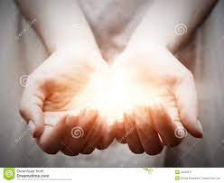

Slide 28
I believe in God, the Father almighty, creator of heaven and earth.
I believe in Jesus Christ, His only Son, our Lord, who was conceived by the Holy Spirit and born of the virgin Mary. He suffered under Pontius Pilate, was crucified, died, and was buried; he descended to hell.

Slide 29
The third day He rose again from the dead. He ascended to heaven and is seated at the right hand of God
the Father almighty. From there He will come to judge the living and the dead.

Slide 30
I believe in the Holy Spirit, the holy catholic* church, the communion of saints, the forgiveness of sins, the resurrection of the body, and the life everlasting.
Amen.

Slide 32
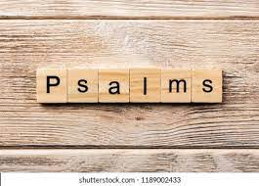

Slide 33
¹ Lord, our Lord, how majestic is Your name in all the earth!
You have set Your glory in the heavens. ² Through the praise of children and infants You have established a stronghold
against Your enemies, to silence the foe and the avenger. ³ When I consider Your heavens, the work of Your fingers, the moon and the stars,

Slide 34
which You have set in place, ⁴ what is humankind that You are mindful of them, humankind that You care for them?
⁵ You have made them
a little lower than the angels and crowned them with glory and honor. ⁶ You made them rulers
over the works of Your hands; You put everything under their feet:

Slide 35
⁷ all flocks and herds, and the animals of the wild, ⁸ the birds in the sky, and the fish in the sea, all that swim the paths of the seas.
⁹ Lord, our Lord, how majestic is Your name in all the earth!

Slide 37
Breathe on me, breath of God, Fill me with life anew, That I may love all that You love, And do what You would do.
1/4

Slide 38
Breathe on me, breath of God, Until my heart is pure, Until with You I will one will, To do and to endure.
2/4

Slide 39
Breathe on me, breath of God, And all my life refine, Until this earthly part of me Glows with Your fire divine.
3/4

Slide 40
Breathe on me, breath of God, So shall I never die, But live with You the perfect life Of Your eternity.
4/4

Slide 44
Pentecost is a moveable feast, which is celebrated on the 50th day (the seventh Sunday) from Easter Sunday. It commemorates the descent of the Holy Spirit upon the Apostles and other followers of Jesus Christ while they were in Jerusalem celebrating the Feast of Weeks, as described in the Acts of the Apostles (Acts 2:1–31). The holiday is also called "White Sunday" or "Whitsunday" or "Whitsun", especially in the United Kingdom, where traditionally the next day, Whit Monday, was also a public holiday (since 1971 fixed by statute on the last Monday in May). The Monday after Pentecost is a legal holiday in many European countries.

Slide 45
Judaism the Festival of Weeks (Hebrew: שבועות‎ Shavuot) is a harvest festival that is celebrated seven weeks and one day after the first day of Passover (the Feast of Unleavened Bread) in Deuteronomy 16:9 or seven weeks and one day after the Sabbath referred to in Leviticus 23:16.The Festival of Weeks is also called the feast of Harvest in Exodus 23:16 and the day of first fruits in Numbers 28:26. In Exodus 34:22 it is called the "first-fruits of the wheat harvest."

Slide 46
The date for the "Feast of Weeks" originally came the day after seven full weeks following the first harvest of grain. In Jewish tradition the fiftieth day was known as the Festival of Weeks. The actual mention of fifty days comes from Leviticus 23:16.

Slide 48
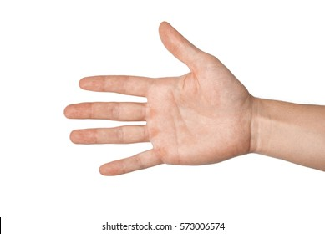
The right hand of God??
Judges 3:12-28
A place of favour and closeness to God

Slide 49
Ehud Judges 3
¹² Again the Israelites did evil in the eyes of the Lord, and because they did this evil the Lord gave Eglon king of Moab power over Israel. ¹³ Getting the Ammonites and Amalekites to join him, Eglon came and attacked Israel, and they took possession of the City of Palms. ¹⁴ The Israelites were subject to Eglon king of Moab for eighteen years.
¹⁵ Again the Israelites cried out to the Lord, and he gave them a deliverer—Ehud, a left-handed man, the son of Gera the Benjamite. The Israelites sent him with tribute to Eglon king of Moab. ¹⁶ Now Ehud had made a double-edged sword about a cubit long, which he strapped to his right thigh under his clothing. ¹⁷ He presented the tribute to Eglon king of Moab, who was a very fat man. ¹⁸ After Ehud had presented the tribute, he sent on their way those who had carried it. ¹⁹ But on reaching the stone images near Gilgal he himself went back to Eglon and said, “Your Majesty, I have a secret message for you.”
The king said to his attendants, “Leave us!” And they all left.
²⁰ Ehud then approached him while he was sitting alone in the upper room of his palace and said, “I have a message from God for you.” As the king rose from his seat, ²¹ Ehud reached with his left hand, drew the sword from his right thigh and plunged it into the king’s belly. ²² Even the handle sank in after the blade, and his bowels discharged. Ehud did not pull the sword out, and the fat closed in over it. ²³ Then Ehud went out to the porch; he shut the doors of the upper room behind him and locked them.
²⁴ After he had gone, the servants came and found the doors of the upper room locked. They said, “He must be relieving himself in the inner room of the palace.” ²⁵ They waited to the point of embarrassment, but when he did not open the doors of the room, they took a key and unlocked them. There they saw their lord fallen to the floor, dead.
²⁶ While they waited, Ehud got away. He passed by the stone images and escaped to Seirah. ²⁷ When he arrived there, he blew a trumpet in the hill country of Ephraim, and the Israelites went down with him from the hills, with him leading them.
²⁸ “Follow me,” he ordered, “for the Lord has given Moab, your enemy, into your hands.” So, they followed him down and took possession of the fords of the Jordan that led to Moab; they allowed no one to cross over. ²⁹ At that time they struck down about ten thousand Moabites, all vigorous and strong; not one escaped. ³⁰ That day Moab was made subject to Israel, and the land had peace for eighty years.

Slide 51
What is a Creed?
A creed is simply a statement of faith.
When asked by Jesus Christ,
"Who do you say that I am?"
Peter’s response was his creed:
“You are the Christ, the Son of the Living God." (Matt 16:15-16)
The English word "creed" comes from Latin "credo" which means "I believe."

Slide 52
The following points will summarize the background of creeds in general:
* Creeds vary according to form.
* Creeds vary according to content.
* Creeds contain the statements of belief
that the authors believed were necessary for salvation or to the well-being of the true church.
* Most creeds arose out of a need to address with the truth a particular heresy circulating at the time. Each creed tends to place an emphasis
on the principle of faith under attack at that time.
* Creeds are always subordinate to the Bible.
* The value of a creed is dependent upon its
measure of agreement with Scripture.

Slide 53
* Creeds are always subordinate to the Bible.
The value of a creed is dependent upon its measure of agreement with Scripture.
It was not written by the Apostles but is in full agreement with the teaching of the Apostles as contained in the New Testament. The earliest trace of the Apostles Creed goes back to Ignatius late 1st & early 2nd C AD.

Slide 54
In his writings he states that Christ was truly born "of the Virgin Mary, suffered under Pontius Pilate, was crucified and died and was raised from the dead."
As a whole the complete text of the Apostles’ Creed cannot be traced beyond the end of the 5th century AD.

Slide 55
I believe in God the Father Almighty, Isa 44:6, 45:5
Maker of heaven and earth, Gen 1:1, John 1:1
Acts 14:15
And in Jesus Christ Luke 2:11, John 20:28
His only Son John 3:16, Prov 30:4
Our Lord John 20:28
Who was conceived Luke 1:35
by the Holy Spirit
Born of the Virgin Mary Luke 1:27

Slide 56
Suffered under Pontius Pilate Luke 23:23-25
Was crucified John 19:20, Acts 4:10
Dead 1 Corinthians 15:3
And buried 1 Corinthians 15:4
He descended into Hell 1 Peter3:18, Luke 23:43
On the third day 1 Corinthians 15:4
He arose form the dead 1 Corinthians 15:4
He ascended into heaven Mark 16:19,Luke 24:51,
Acts 1:11

Slide 57
And is seated at the right-hand Mark 16:19, Heb 1:3
of God the Father Almighty
From thence he shall come to 2 Tim 4:1, John 5:22
judge the quick and the dead
I believe in the Holy Spirit John 15:26, 16:7-8, 13-14,
Acts 13:2
The holy catholic church Gal 3:26-29
The communion of saints Rev 9:14, Heb10:25
The forgiveness of sins Luke 7:48

Slide 58
The resurrection of the body 1 Thess 4:16, John 6:39
And the life everlasting John 10:28, 17:2-3

Slide 60
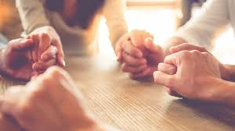

Slide 61
Our Father in heaven,
hallowed be Your name,
Your kingdom come,
Your will be done
On earth as in heaven.
Give us today our daily bread.

Slide 62
And forgive us our sins,
As we forgive those
who sin against us.
Save us from the time of trial,
And deliver us from evil.
For the kingdom, the power
and the glory are Yours,
Now and forever. Amen.

Slide 64
Spirit divine, attend our prayers and make this house Your home; descend with all Your gracious powers: O come, great Spirit, come.
1/6

Slide 65
Come as the light: to us reveal our emptiness and woe, and lead us in those paths of life where all the righteous go.
2/6

Slide 66
Come as the fire: and purge our hearts like sacrificial flame; let our whole life an offering be to our Redeemer's name.
3/6

Slide 67
Come as the dove: and spread Your wings, the wings of peaceful love, and let Your Church on earth become blest as the Church above.
4/6

Slide 68
Come as the wind, with rushing sound and pentecostal grace, that all of woman born may see the glory of Your face.
5/6

Slide 69
6 Spirit divine, attend our prayers, make this lost world Your home; descend with all your gracious powers; O come, great Spirit, come.
6/6

Slide 71
Good morning and have
a great week

